Slide 1
British Airways
Predictive model and its results
2022-11-09

Slide 2
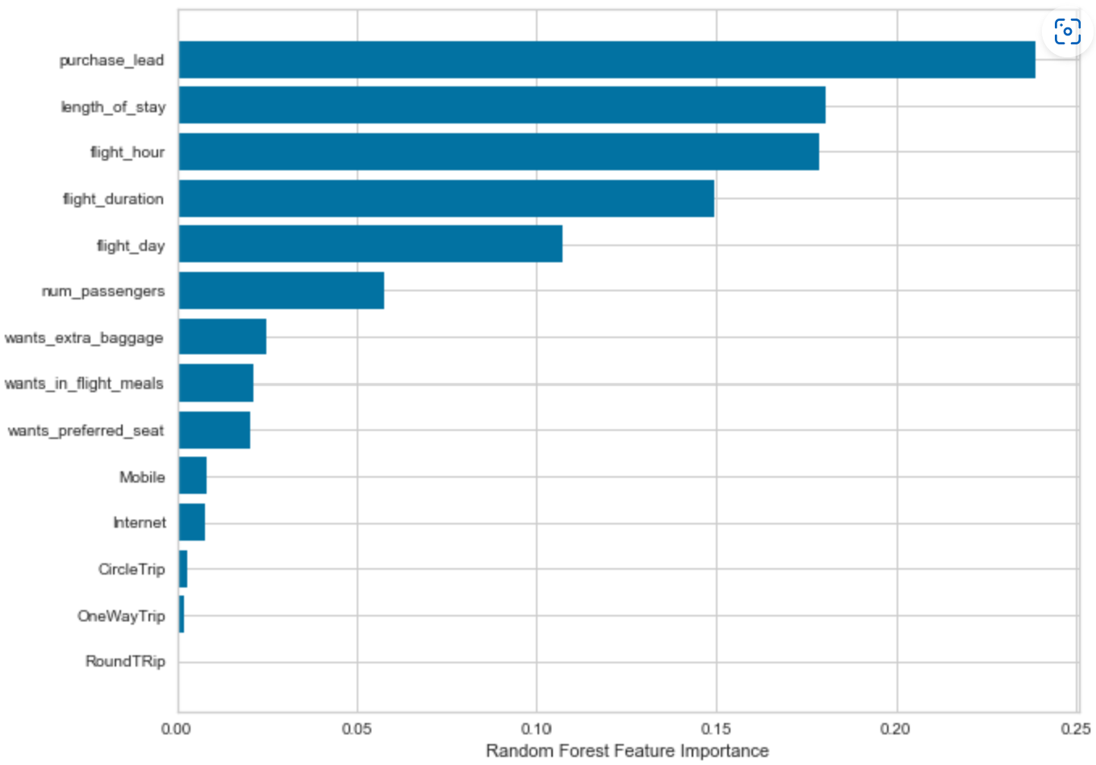
Predictive modelling results
Recall Rate
60%
Precision
61%
Chance of predicting true successful bookings.
Will be predicted as actually completed bookings out of all successfully completed bookings.
Chance of predicting true successful bookings.
66% Chance of predicting true incomplete bookings correctly.
Accuracy of the model predicting successful or incomplete booking is
Accuracy
62%
Accuracy of the model predicting successful or incomplete booking is
Top features that can drive successful flight bookings.

